Slide 1
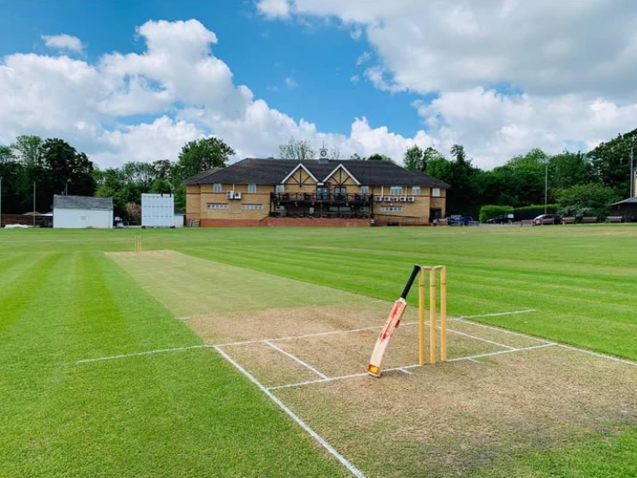

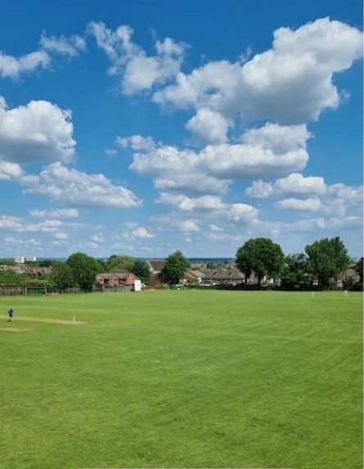


JUNIOR CRICKET AT
HOLTWHITES-TRINIBIS CC
Are you looking to join a cricket club?
Recruiting junior players aged 6-16 for the 2026 season
We’re a very welcoming and friendly club based in Enfield
Six competitive junior teams in Middlesex Leagues and Cups
Further match opportunities
Weekly training with qualified DBS checked coaches
ECB Clubmark accredited
OUTDOOR TRAINING (starts 12 April) – with Sunday BBQ!
Softball - Sunday 9:30-11:00
U11/U12/U13 - Sunday 9:00-10:30
U14/U15 - Sunday 10:30-12:00
U17 – Wednesdays 6:00-7:30 (with seniors)
Includes membership to Holtwhites Sports & Social Club
For any enquiries, contact Martyn Driscoll on 07803857423
or Guy Waller on 07976299917

